Slide 1


Pragmatic CQRS
Lucas Jellema, CTO & Architect at AMIS
Digital Xchange Bergisches Rheinland, May 2019

Slide 2



Lucas Jellema Architect / Developer 1994 started in IT at Oracle 2002 joined AMIS Currently CTO & Solution Architect

Slide 3
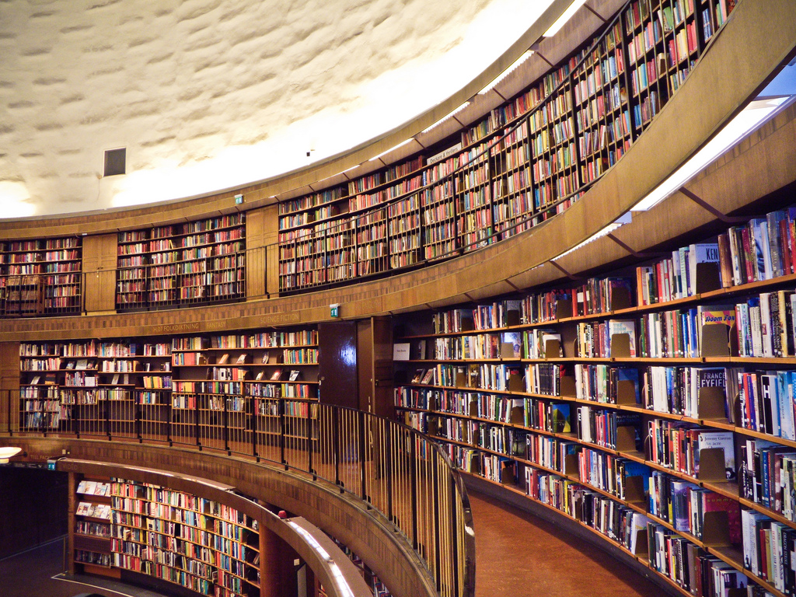
BOL - CQRS

Slide 4

Books Online - WebShop
Products
Webshop visits
searches
product details
Orders
Product updates
Read only
On line
Speed is crucial
XHTML & JSON
> 5M visits
Data manipulation
Data Quality (enforcement)
<10K transactions
Batch jobs next to online
Speed is nice
firewall

Slide 5


Nightly generation
DMZ
Webshop visits
searches
product details
Orders
Products
Products
Products
Products
Product updates
Read only
On line
Speed is crucial
XHTML & JSON
> 1M visits
Read only
JSON documents
Images
Text Search
Scale Horizontally
Stale but consistent
Data manipulation
Data Quality (enforcement)
<10K transactions
Batch jobs next to online
Speed is nice
firewall

Slide 6
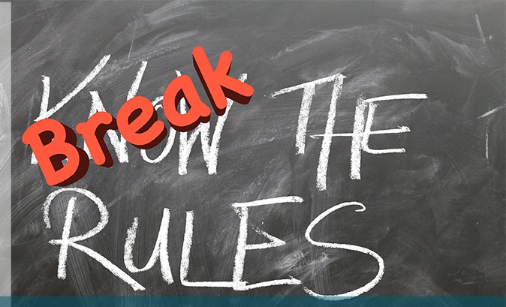
What is different?
DML != Query
Duplication of Data (<> evil)
Data in multiple physical locations
ACID is not an absolute truth
Eventual Consistency (relaxed freshness)
NoSQL – not everything is relational
Data preprocessed, stored and produced for a special consumer
TCO is not a given – and it matters

Slide 7

Why?
Performance
Scalability
Availability
Development productivity
Agility through decoupling
Reduction in TCO

Slide 8
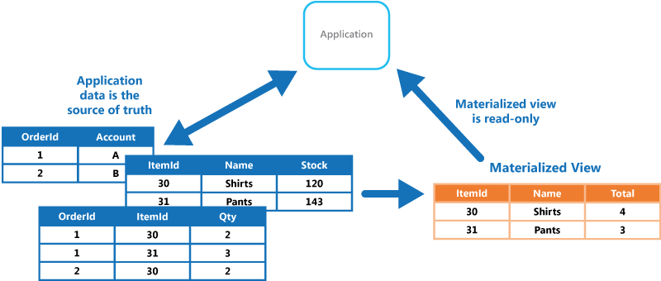
Common mechanism for Duplicating Data to improve performance, scalability and developer productivity
Inserts, Updates and the odd Delete
Many Complex, Heavy Queries: Complex Joins, Expensive Aggregations

Slide 9
Common mechanism for Duplicating Data to improve performance, scalability and developer productivity
Inserts, Updates and the odd Delete
Many Simple Cheap Queries
Many Simple Cheap Queries
Required and feasible consistency: REFRESH ON COMMIT
or scheduled refresh

Slide 10









Utility Company looking for Performance, Scalability and Availability in their core data sets
Marketing Campaigns
Invoicing
CRM
Billing
batch
Meter Readings
Load on Core Systems & effect on Performance
Availability Core Systems

Slide 11
Utility Company looking for Performance, Scalability and Availability in their core data sets
Marketing Campaigns
CRM
Invoicing
CRM Cache DB
Meter Readings
Billing
Meter Readings Cache DB

Slide 12



Utility Company looking for Performance, Scalability and Availability in their core data sets
Marketing Campaigns
CRM
Invoicing
CRM Cache DB
Meter Readings
Billing
Meter Readings Cache DB

Slide 13
Practical Challenges
Marketing Campaigns
Publish all change events from sources
Event schema evolution
Lag in Cache Databases
“eventual consistency”
Differences between sources and cache databases
Initial creation of Cache Databases
Scale and event storm
Business and Mission Critical availability
Data Authorization
Logic enforced in source (applications)
GDPR
CRM
Invoicing
CRM Cache DB
Meter Readings
Billing
Meter Readings Cache DB

Slide 14
CQRS
Products
Data Manipulation
Data Retrieval

Slide 15

Same Data, Multiple – different – Usage Scenarios
Different in:
Why
What – grain, aggregation, breadth, type of and variation in queries
How – format, language, accuracy and freshness, consistency
When – frequency, time of day | week | month, 24/7
Where – latency, band width, off line
Who – scale, different roles & user groups

Slide 16
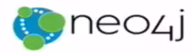




CQRS: Command Query Responsibility Segregation
Products
Data Manipulation
Quick Product Search Index
Special Products
Data Retrieval
Toys
Product Clusters
Product Store in SaaS app
Food Stuff
Notes:
Data manipulation and retrieval in separate places
(physical data proliferation)
Query store is optimized for consumers
Level of detail, format, filters applied
For performance and scalability, independence, productivity lower license fees and lower TCO, security

Slide 17


MongoDB
ORDERS
Oracle Database
DVX_ORDERS

Slide 18


MongoDB
ORDERS
Oracle Database
DVX_ORDERS

Slide 19
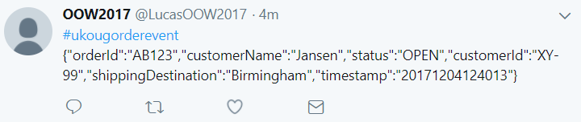

MongoDB
ORDERS
19
DML
Oracle Database
DVX_ORDERS

Slide 20

MongoDB
µ
ORDERS
20
DML
Oracle Database
µ
DVX_ORDERS

Slide 21
CQRS Steps and Challenges
Products
Data Manipulation
Quick Product Search Index
Special Products
Data Retrieval
Toys
Product Clusters
Product Store in SaaS app
Food Stuff
Notes:
Data manipulation and retrieval in separate places
(physical data proliferation)
Query store is optimized for consumers
Level of detail, format, filters applied
For performance and scalability, independence, productivity lower license fees and lower TCO, security

Slide 22
CQRS Steps and Challenges
Spot and Handle Errors
Governance & Evolution
Detect changes
Products
Extract Data
Enforce Constraints & Authorization
Data Manipulation
Transport Data
Convert Data
Special Products
Apply Data
Data Retrieval
Toys
Quick Product Search Index
Product Clusters
Food Stuff
Product Store in SaaS app
Notes:
No Event Sourcing
No events (?)
No green field
Packages Applications/SaaS
Databases (RDBMS, NoSQL) getting changes from applications directly
Challenges – at scale, with enough speed and consistently: do not let query store get into an exposed state that could not exist/be right!
Detect relevant changes
Extract relevant changes
Transport
Convert
Apply in correct order and reliably (no lost events)
Note: after detect and extract, an event can be published

Slide 23
From C to Q
How quickly?
How frequently?
How reliably?
How atomically?
Products
Quick Product Search Index

Slide 24
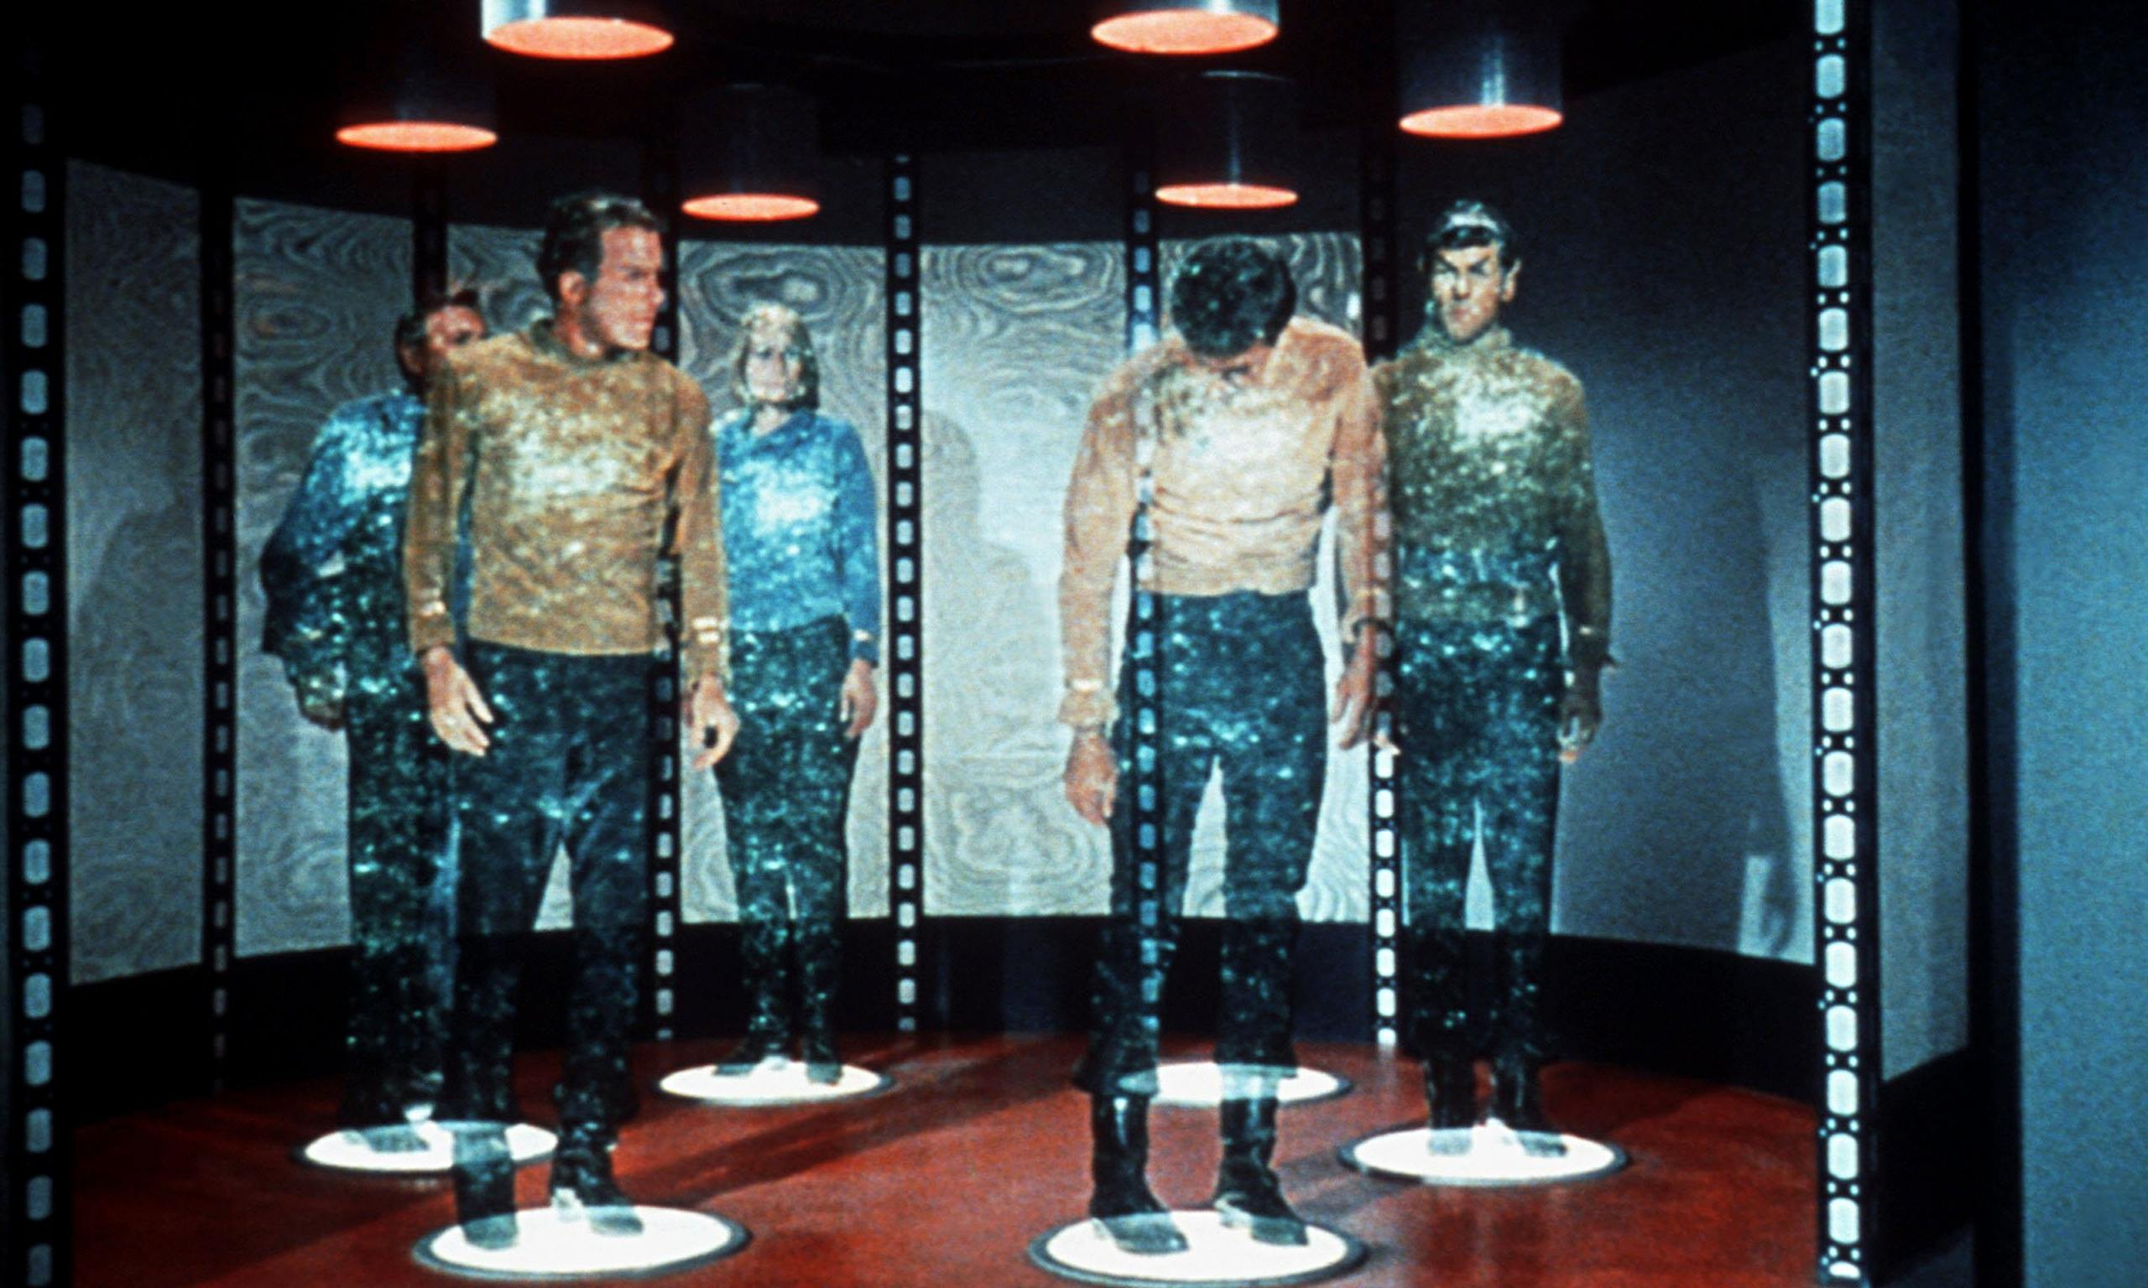

Slide 25
From C to Q
How quickly?
How frequently?
How reliably?
How atomic?
Data Authorization Considerations
Locations & Connectivity
Full resynch | restore of Query Store
Products
Quick Product Search Index

Slide 26
Typical CQRS Architecture
Source systems
Change Reporters
Distributed Change Event Hub
Change Projectors
Destination systems
Transform & Apply
Poll
Event Platform
Detect & Retrieve Change
(re)Calculate & Record
Consume
Convert, Translate, Store
Event Schema Governance
Monitoring & Error Handling
Notes:
Destination system: can be cache, or even only the programmatic representation – without any data duplication
Dumb pipes, smart end points

Slide 27
Technologies to support CQRS
Detecting and Extracting and Publishing Changes
Database specific change detection
Debezium, Kafka Connect, SOA Suite Inbound Adapters,
Cloud Adapters in iPaaS platforms and SaaS products
Decoupled gathering & queueing of change events (preferably distributed and technology agnostic; options for long term event retention)
Kafka, Rabbit MQ, AWS SQS, JMS
Handling change – transport, transform, apply
Query Stores – picked based on data use case requirement, not for CQRS
Any database, in memory cache

Slide 28
Detecting and Extracting and Publishing Changes Oracle Database as source
Poll
Oracle GoldenGate, Oracle Data Integrator
Data Integration Platform Cloud
SOA Suite Inbound Database Adapter
Custom:
Polling
Log Mining
Triggers (publishing DML change events)
Record in Table or AQ/JMS
Push over HTTP
Write to file
Materialized View (Log)
Flashback Query
Continuous Query Notification (DB QRCN)
To PL/SQL package or Java application
Detect & Retrieve Change
Consume

Slide 29
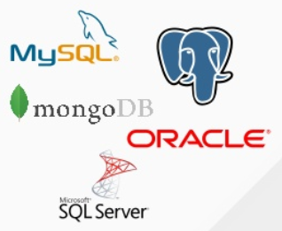

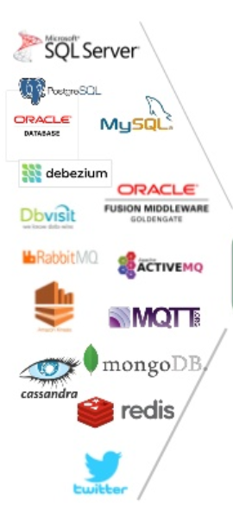


Detecting and Extracting and Publishing Changes from many sources – Debezium, Kafka Connect, Apache Kafka
CDC
Debezium
Apache Kafka
Notes:
MySQL: binlog; Postgres: wnte-ahead log; MongoDB op log

Slide 30
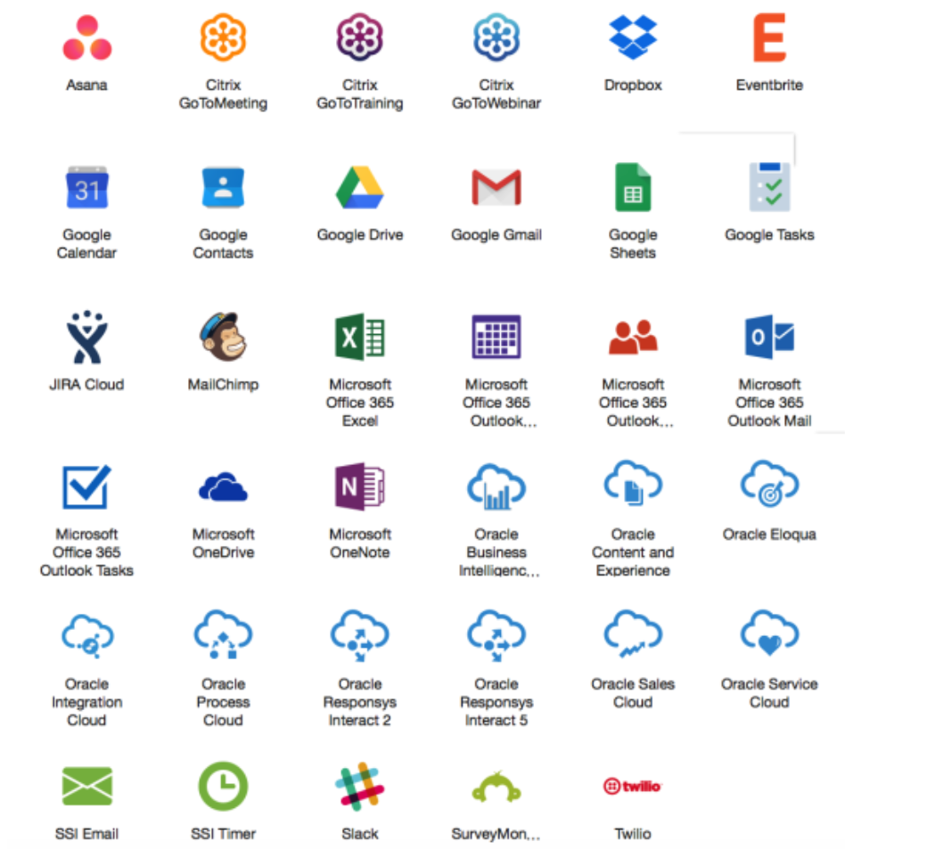
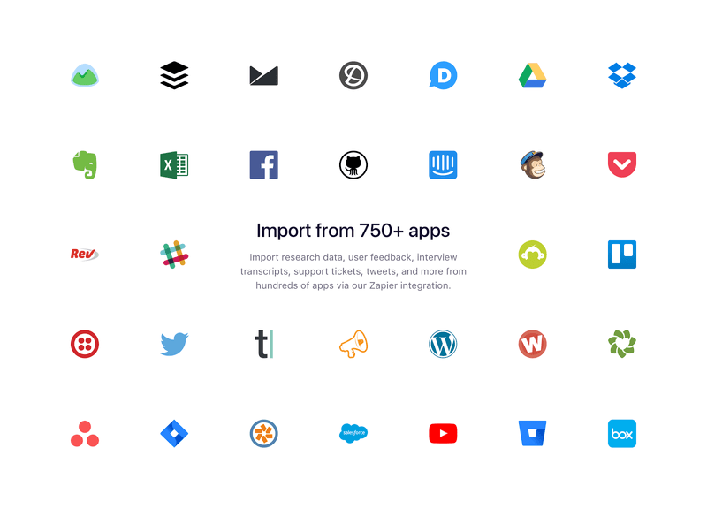
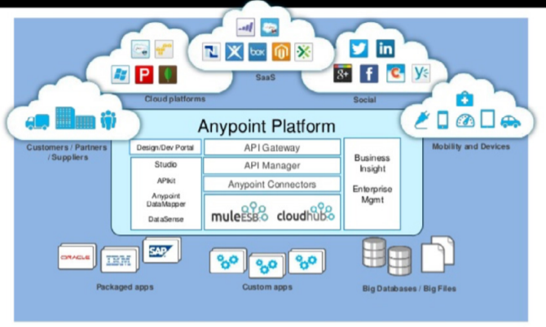
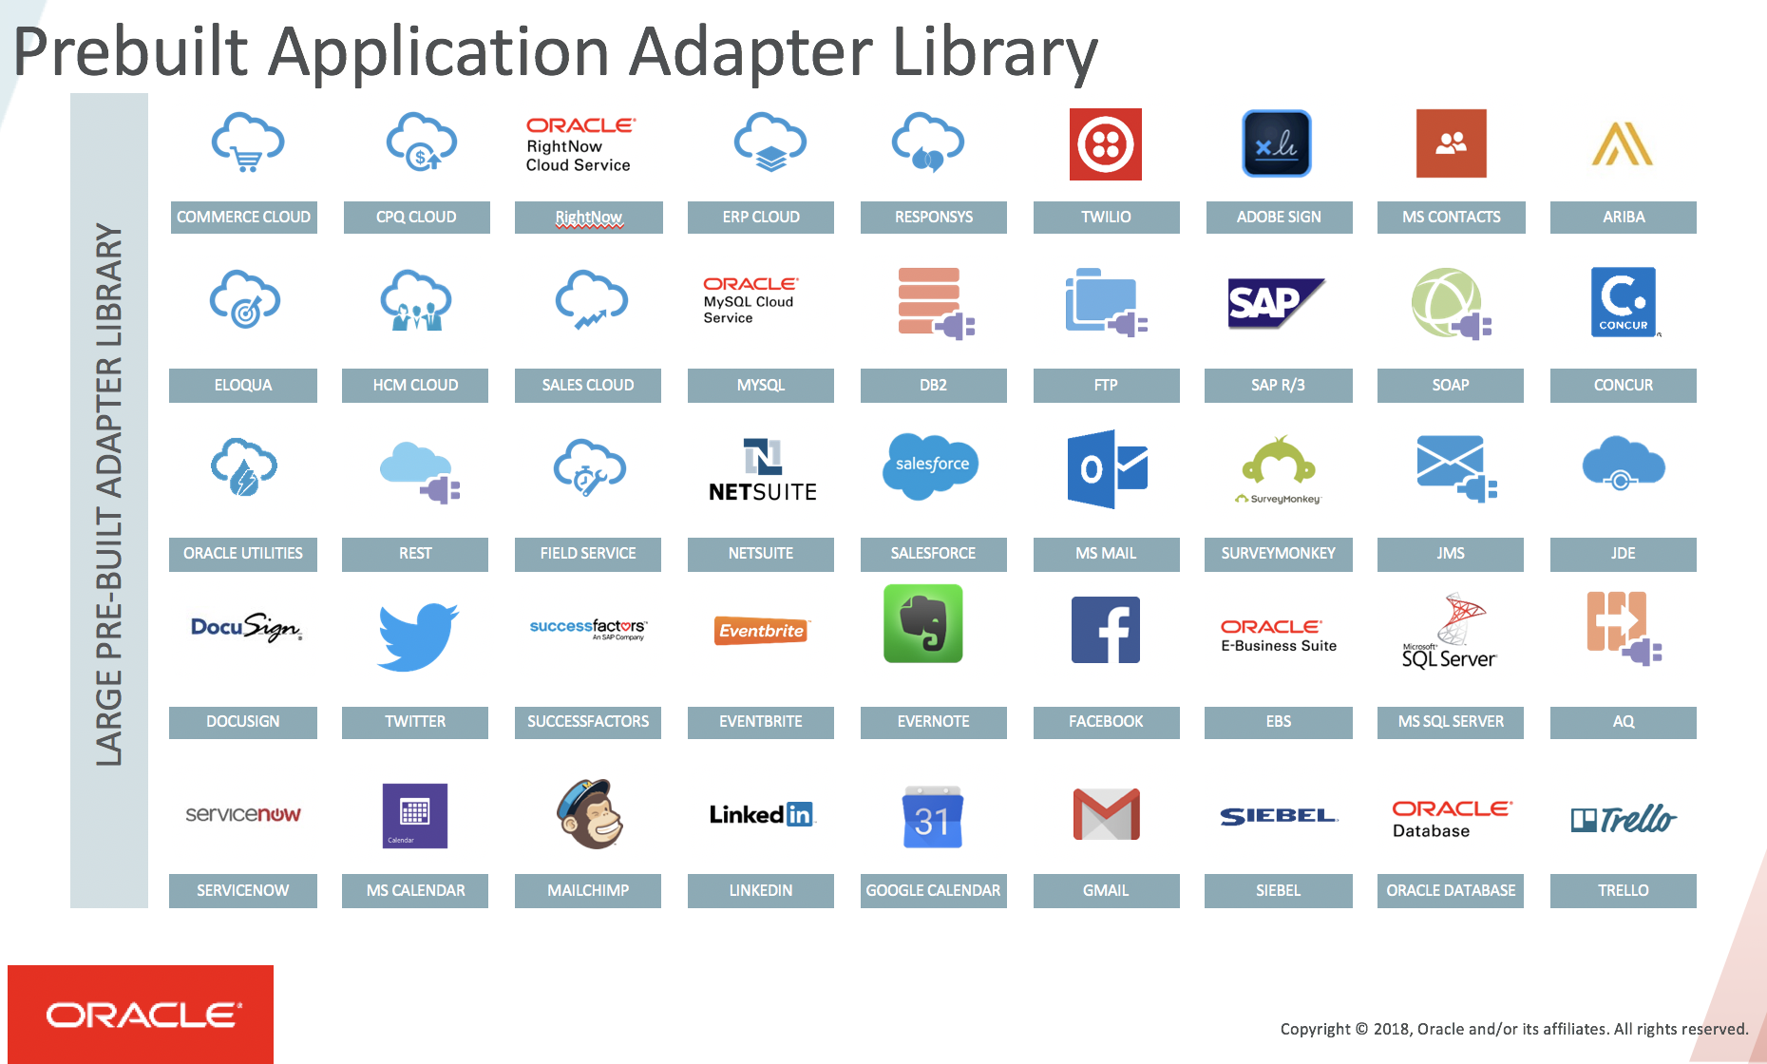
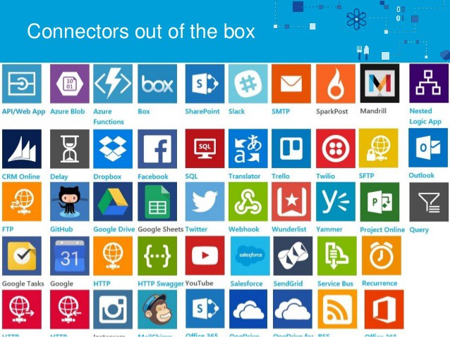
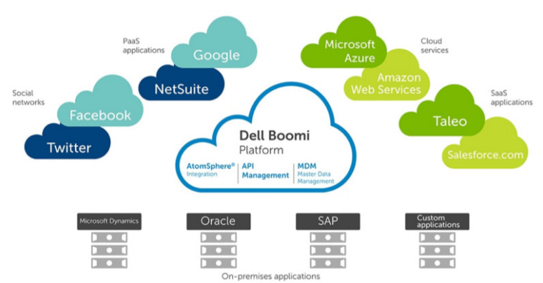
iPaaS (Cloud) Adapters for SaaS & Platform
Prepackaged Change Event Detectors
Notes:
AnyPoint
Zapier
SSI
OIC
Dell Boomi

Slide 31
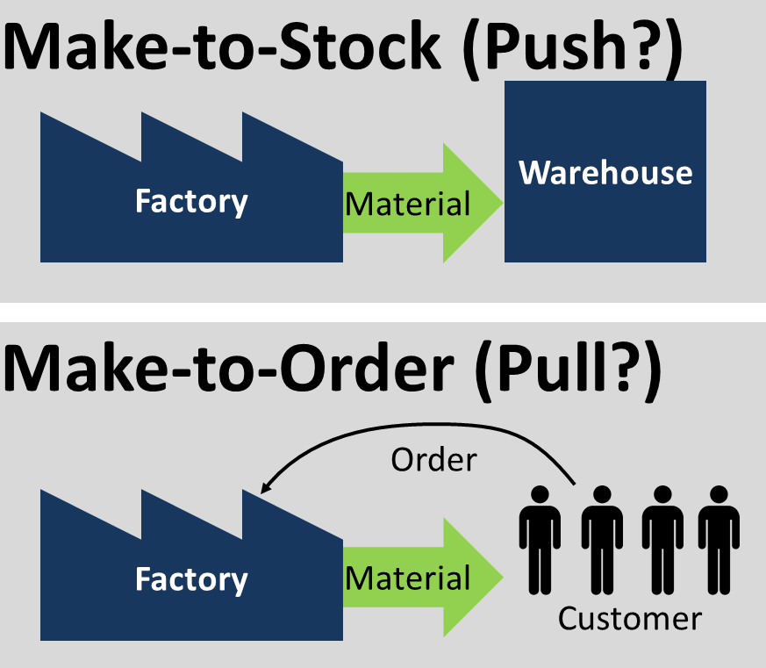
JIT vs AOT

Slide 32
Ahead of Time
Prepare products Ahead of Time instead of upon request
When the time to deliver (to request) is too long
When the complexity of a JIT-approach is too high
When the capacity does not allow for JIT-peak production
When the overhead and waste of AOT are justified

Slide 33
JIT vs AOT Data Integration
JIT
Process [synchronous] request for data ‘just in in time’
Only data that is requested
Fresh as can be
All authorization rules applied
Single Source of Truth
Transformation & Aggregation at request time
Hard (runtime) dependencies from consumer on producer
AOT
Pre-process / pre-share data ‘ahead of time’
Potentially includes data that will never be requested
Data can be outdated

Slide 34
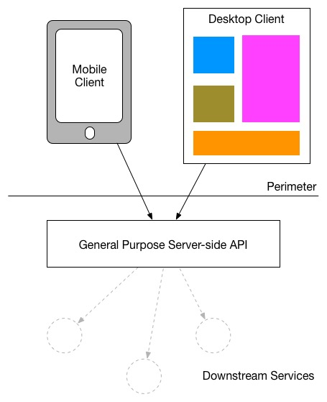
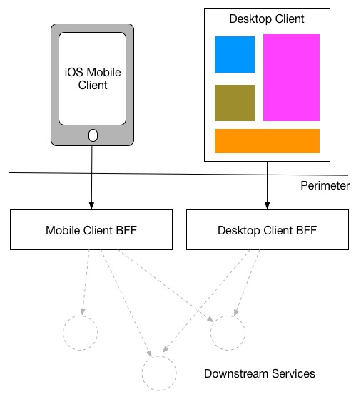
Backend For Frontend

Slide 35

CQRS => Data Backend For Frontend: Optimized data set for special use case
Shape & Format
Right Grained (aggregation, consolidation)
Filtered
Enriched (from multiple sources)
Location
Time (refreshed at the right time)
Search Options
BASE (eventually – when? – consistent)
Authorization
GDPR
UI
APIs
(backend for frontend)
Data Store
Master Database

Slide 36
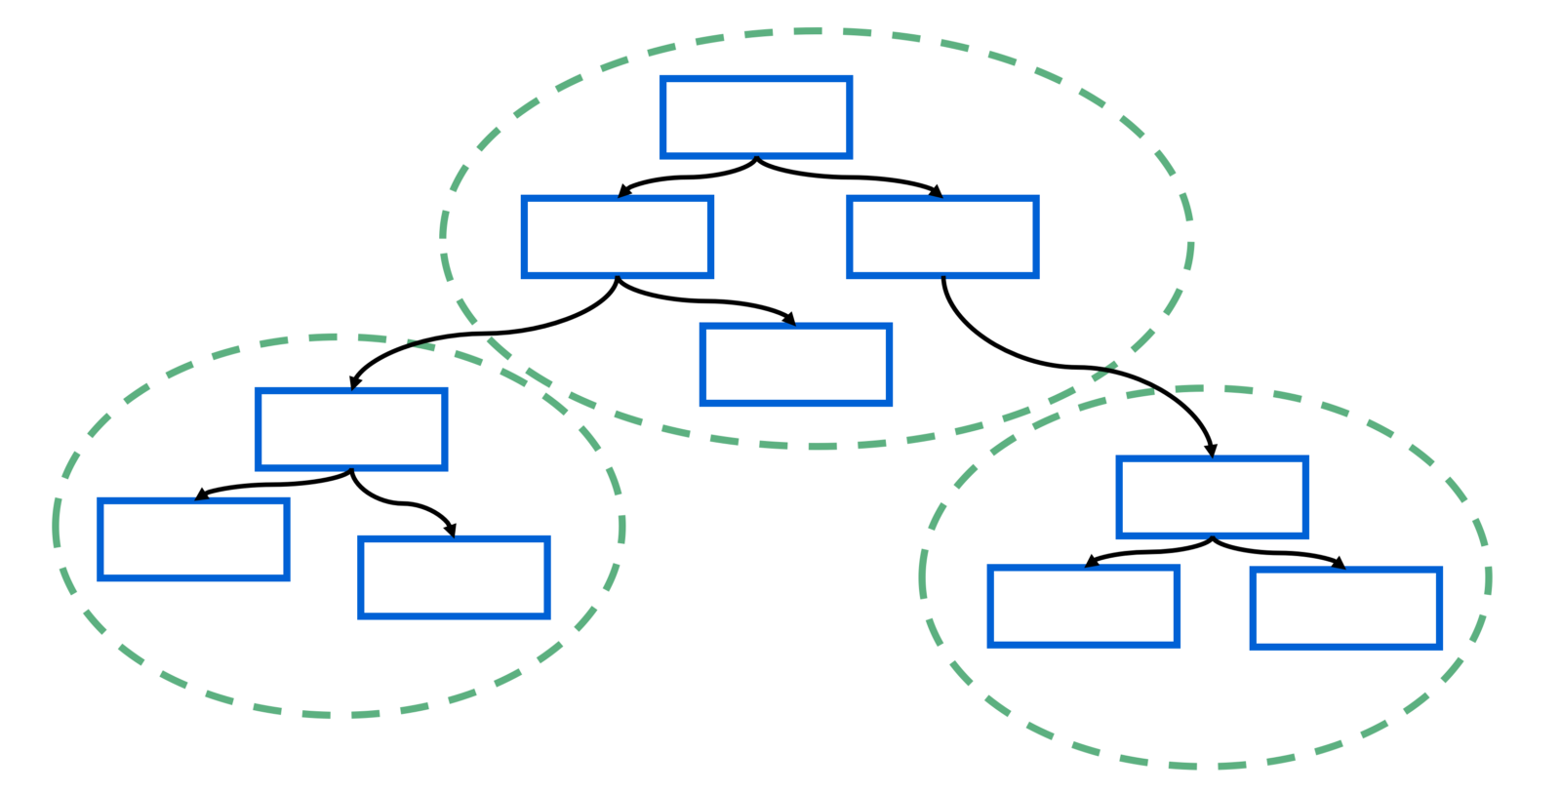
Domain Driven Design
Context Mapping and Bounded Context
Ubiquitous Language
Microservices
Domain Events
Anti Corruption Layer (ACL)
Autonomous Bubble pattern

Slide 37
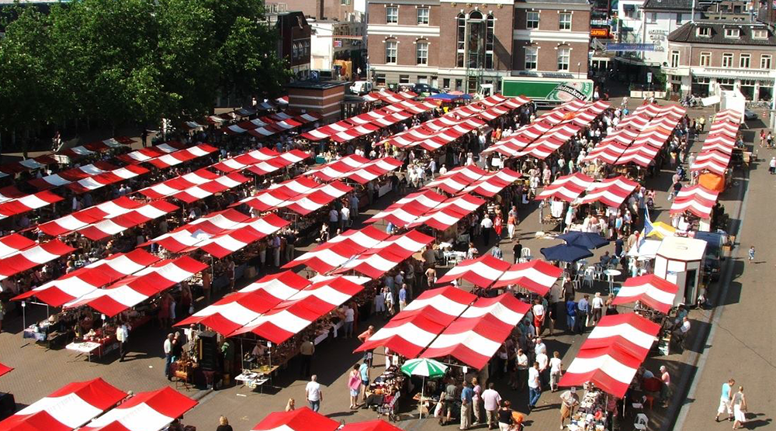
Final Demo
Microservices
Microservice

Slide 38
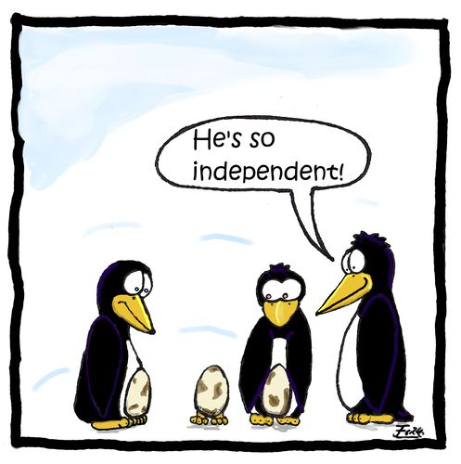
Microservices
Agile | Flexible | Scalable | (Re)Deployable
Independent | Decoupled | Isolated
Communicate asynchronously, via events
Have their own private bounded context – the data they require to function
Their lifeblood

Slide 39
Microservices State
Generic Platform for running microservices
LDAP
Big Data
Block Storage
Cache
RDBMS
NoSQL
Document Store
Event Hub
Notes:
All data stores are distributed
Or at least distributedly available
They can be local or on cloud (latency is important)
Data in generic data store is still owned by only one microservice – no one can touch it
Only in DWH and BigData do we deliberately take copies of data and disown them

Slide 40
Bounded context of microservices
A micoservice needs to be able to run independently
It needs to contain & own all data required to run
It cannot depend on other microservices
UI
API
Customer
API
Order
CustomerModified event

Slide 41






Demo – Maintaining Derived Data in Bounded Context
Customer Microservice
Order Microservice
Customer Modified Event
Application Container
Application Container
Event Hub
Customers
Topic
DBaaS

Slide 42
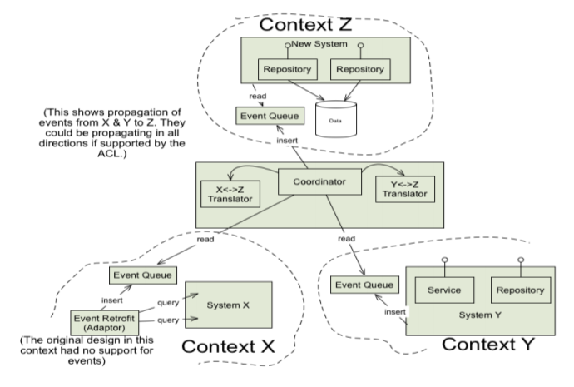
Autonomous Bubble pattern in DDD
Getting started with Domain Driven Design in the context of Legacy Systems
Synchronizing Anti Corruption Layer
Translate anything that crosses a context boundary
Notes:
http://domainlanguage.com/wp-content/uploads/2016/04/GettingStartedWithDDDWhenSurroundedByLegacySystemsV1.pdf

Slide 43
Autonomous Bubble pattern in DDD
New Application
Anti Corruption Layer
Legacy
Anti Corruption Layer
Other Context

Slide 44
Autonomous Bubble pattern in DDD
New Application
Coordinator
Q
Anti Corruption Layer
Legacy
Anti Corruption Layer
Coordinator
Q
consume
Other Context
Event Publisher
Q
Event Publisher

Slide 45
Event Sourcing

Slide 46
Utility Company: Rebuild Cache Database
CRM
CRM Cache DB
Meter Readings
Meter Readings Cache DB

Slide 47
Utility Company: Rebuild Cache Database From Event Store
CRM Cache DB
Meter Readings Cache DB

Slide 48
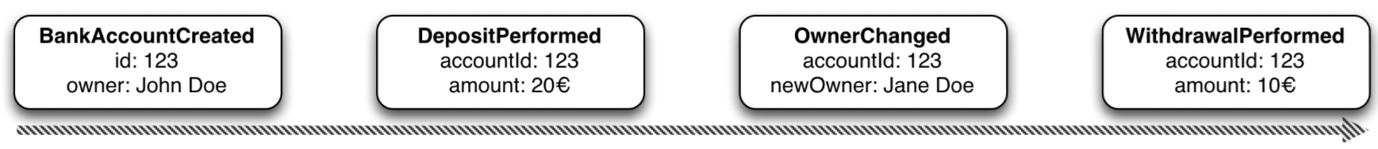
Event Sourcing Driving CQRS
amount: 10
Owner: Jane Doe
Events
Current State
Event Store
accountId: 123
Notes:
Events are immutable facts
Current state (active record) is derived from sum of events
Read optimized aggregates are created for specific use case – based on events and rebuildable at any time

Slide 49
Event Sourcing Driving CQRS
Events
Current State
Event Store
Other State Aggregate
Notes:
Events are immutable facts
Current state (active record) is derived from sum of events
Read optimized aggregates are created for specific use case – based on events and rebuildable at any time

Slide 50
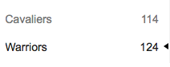

Event Sourcing
Event Store is immutable – append-only log of domain state transitions
Replay events
to (re)construct a representation of the current state (aggregate)
up to a specific time to recreate moments in time
in Test environment to investigate an issue
on a remote location to create mirror & share state across boundaries
produce a fine grained audit trail
Challenges
Time required to reconstruct state
Grain of aggregates / definition of domain events

Slide 51
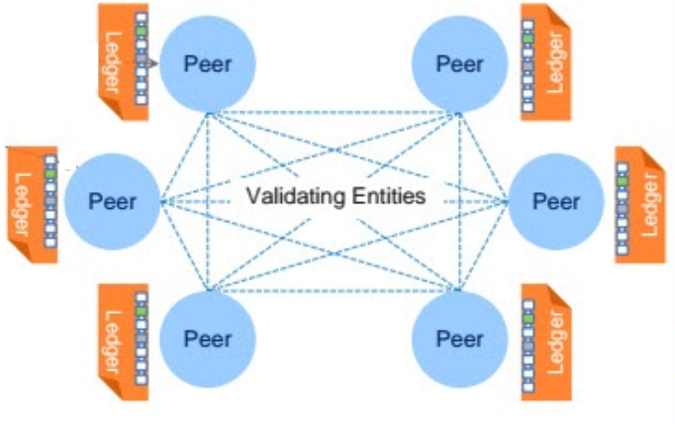

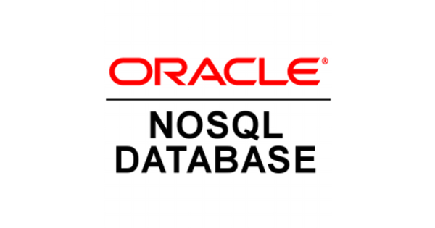



Distributed Database with Event Sourcing & Current State
Transaction
World State
Notes:
Blockchain!

Slide 52
Collective Data Set and Equal Data Position

Slide 53
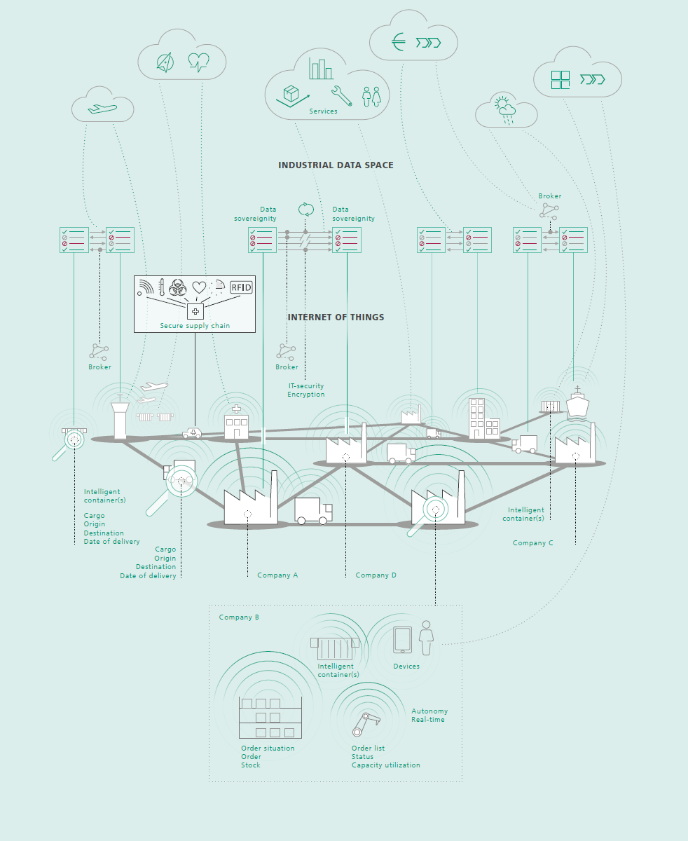
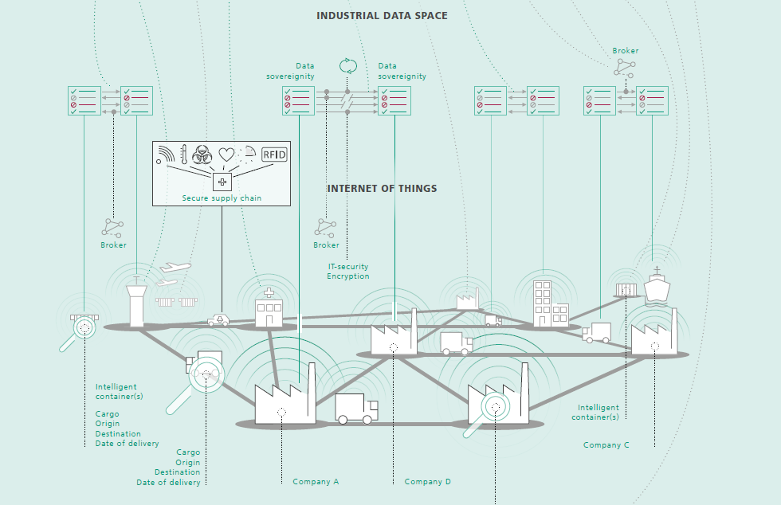
Industrial Data Space

Slide 54
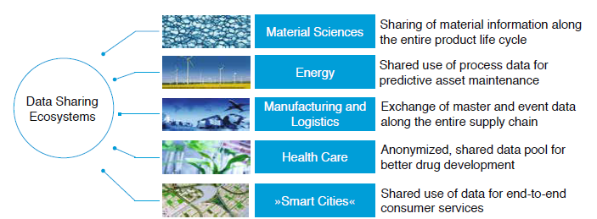
Data Sharing Ecosystems
Multiple independent organizations
Mutually benefit from having access to the same data at the same time
Share data & Have access to data with minimum of overhead and with equality among the ecosystem partners
Partners are on different network domains, physical locations, technology stacks, …
New Partners can join
Partners can leave
Consensus on what constitutes correct data

Slide 55
Collective Dataset
Company A
Company B
Company F
Company C
Collective Dataset
Company E
Company D
Notes:
Central Database plus ESB plus send updates and request data?

Slide 56
Collective Dataset
Company A
Company B
Company F
Company C
Central Database
Enterprise Service Bus
Canonical SOAP WS/ REST API for Sending Inserts/Updates/Deletes and for Requesting current data
Company E
Company D
Just In Time Integration
Notes:
Central Database plus ESB plus send updates and request data?

Slide 57
Collective Dataset = Collective Data Change Events
Company A
Company B
Company F
Company C
Central Event Platform
Interfaces for Publishing and Consuming Events
Note: events can be consumed asynchronously
Company E
Company D
Ahead of Time Integration
Notes:
Central Database plus ESB plus send updates and request data?

Slide 58
Collective Dataset => Collective Data Store
Company A
Company B
Company F
Company C
Company E
Company D
Ahead of Time Integration
Notes:
Central Database plus ESB plus send updates and request data?

Slide 59
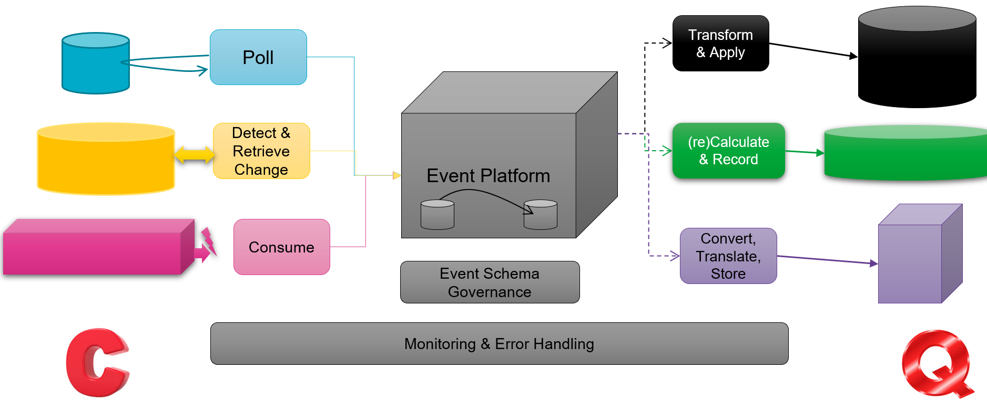
Summary
Why: very different data usage patterns
What: provide tailored query channels for usage patterns (Backend for Frontend)
How: replicate data from source datastore to query store – with appropriate format, grain-level, scalability, location, availability, query options
When: source database(s) cannot fulfil non-functional requirements
With: change detectors & publishers, event platform, change projectors and governance on event definitions, monitoring & error handling
Challenges: scale, speed, consistency, authorization, initial build & full rebuild
Benefits: performance at scale, availability, developer productivity, agility, lower TCO and …

Slide 60




Contact Details
Blog: technology.amis.nl
Email: lucas.jellema@amis.nl
: lucasjellema
: lucas-jellema
: www.amis.nl, info@amis.nl +31 306016000 Edisonbaan 15, Nieuwegein

